Slide 1
Specialty Workshop
Going Farther on Less

Slide 2
Aerodynamics and Friction
Going farther on less: getting the most out of your car.
The four things that you can realistically control:
Electrical efficiency
Losses due to electrical resistance
Losses due to poor gearing
Weight
Rolling friction
Aerodynamic drag

Slide 3
Saint Thomas Academy Experimental Vehicle Team
Our very first project. Built in 1998 for the Minnesota Supermileage Challenge.

Slide 4
Recognizing the importance of aerodynamics early in our program.

Slide 5
Our very first Solar Car for the race from Dallas to Pasadena, CA.

Slide 6
A young Mark Westlake

Slide 7
Our first (and last!) solar array.

Slide 8
Our first (and last!) solar array.

Slide 9
Addition of a Fourth Wheel

Slide 10
Texas Motor Speedway

Slide 11
Reduced Frontal Area and Wheel Shrouds

Slide 12
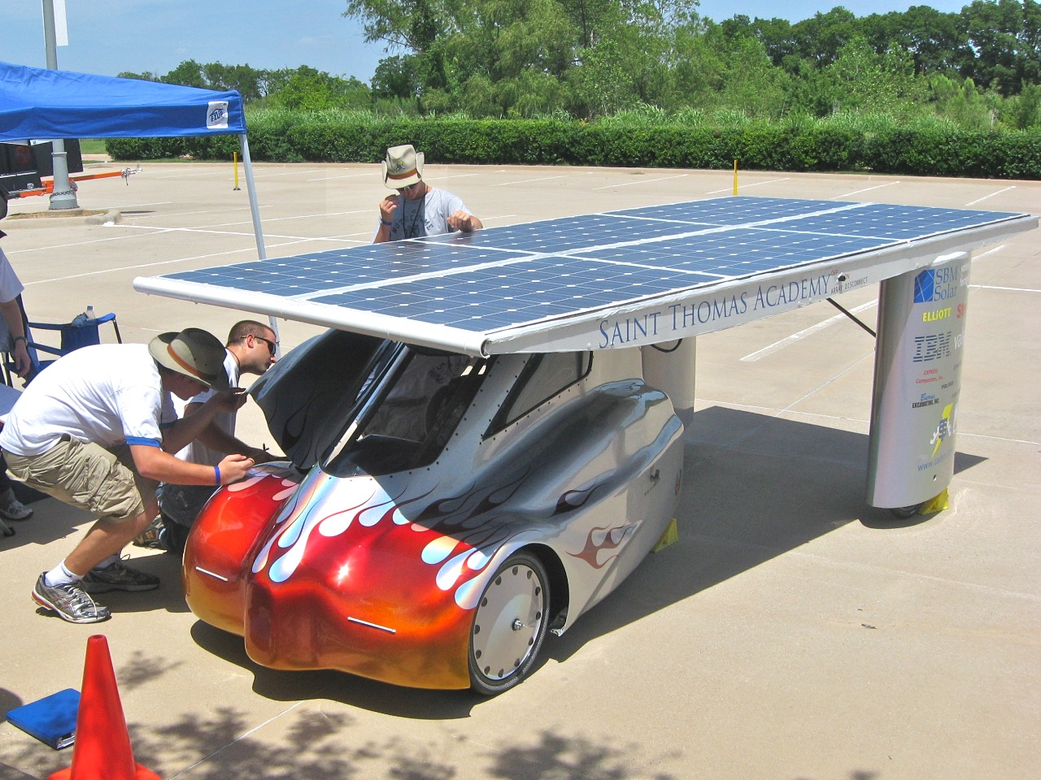
Solar Commuter Vehicle

Slide 13
The start of the body.

Slide 14
The start of the body.

Slide 15
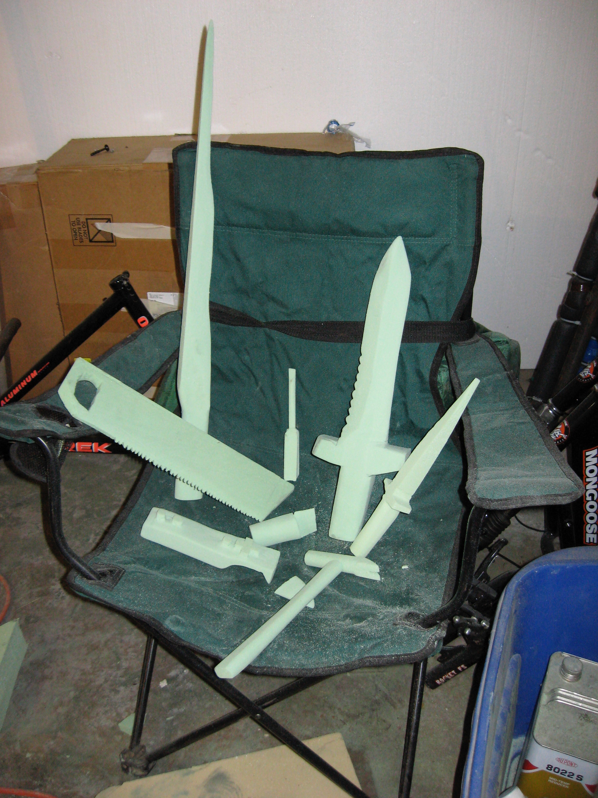
The start of the body.

Slide 16
The start of the body.

Slide 17
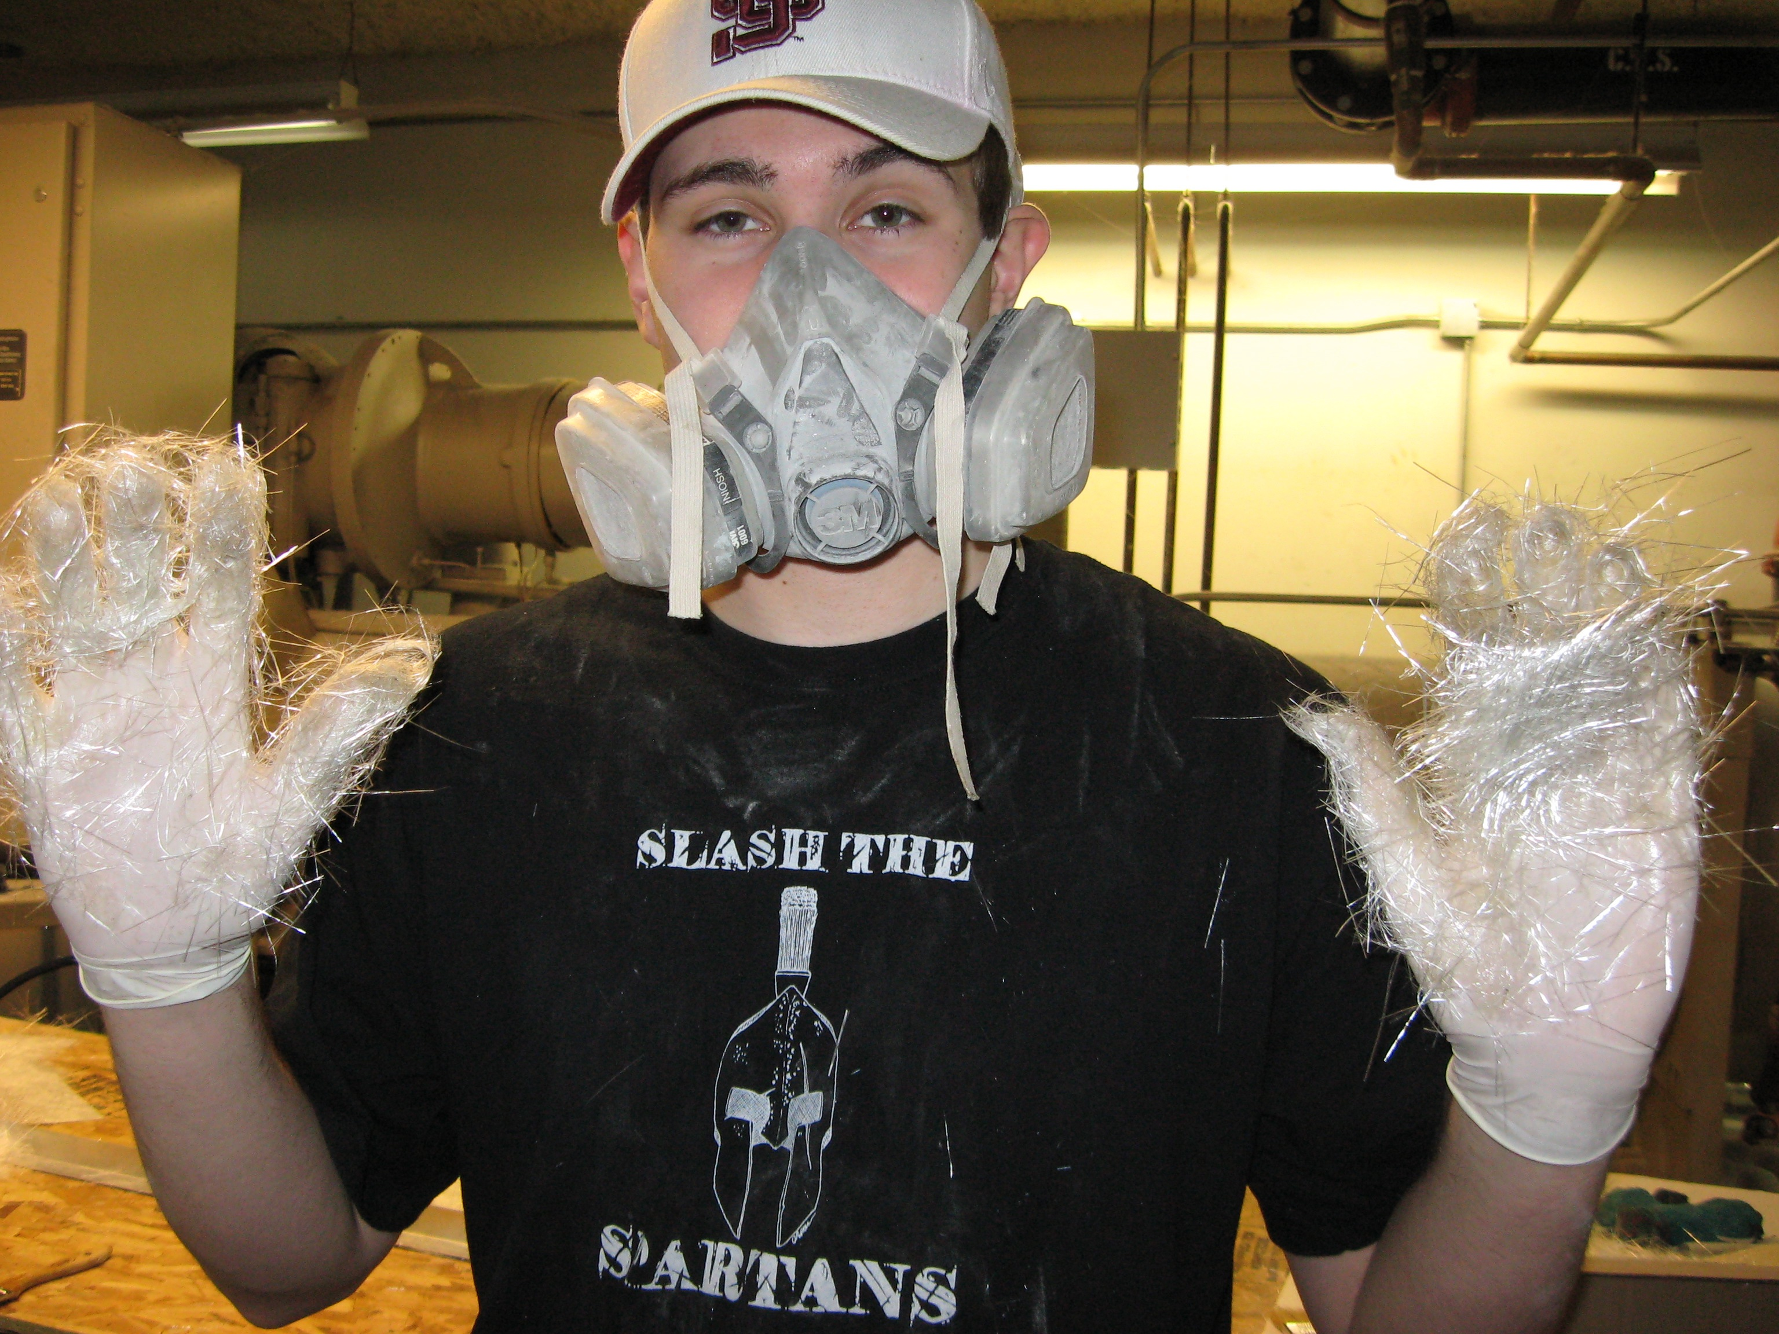
The Fiberglass Mold

Slide 18
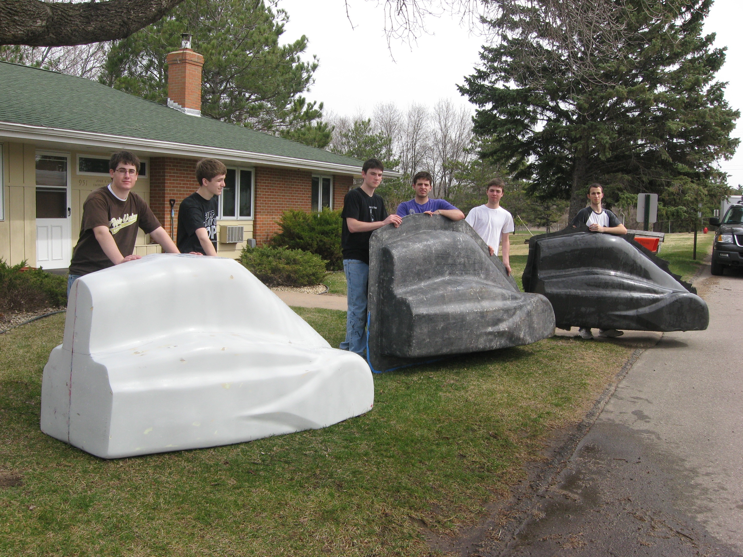
The Fiberglass Mold

Slide 19
Removable Solar Array

Slide 20
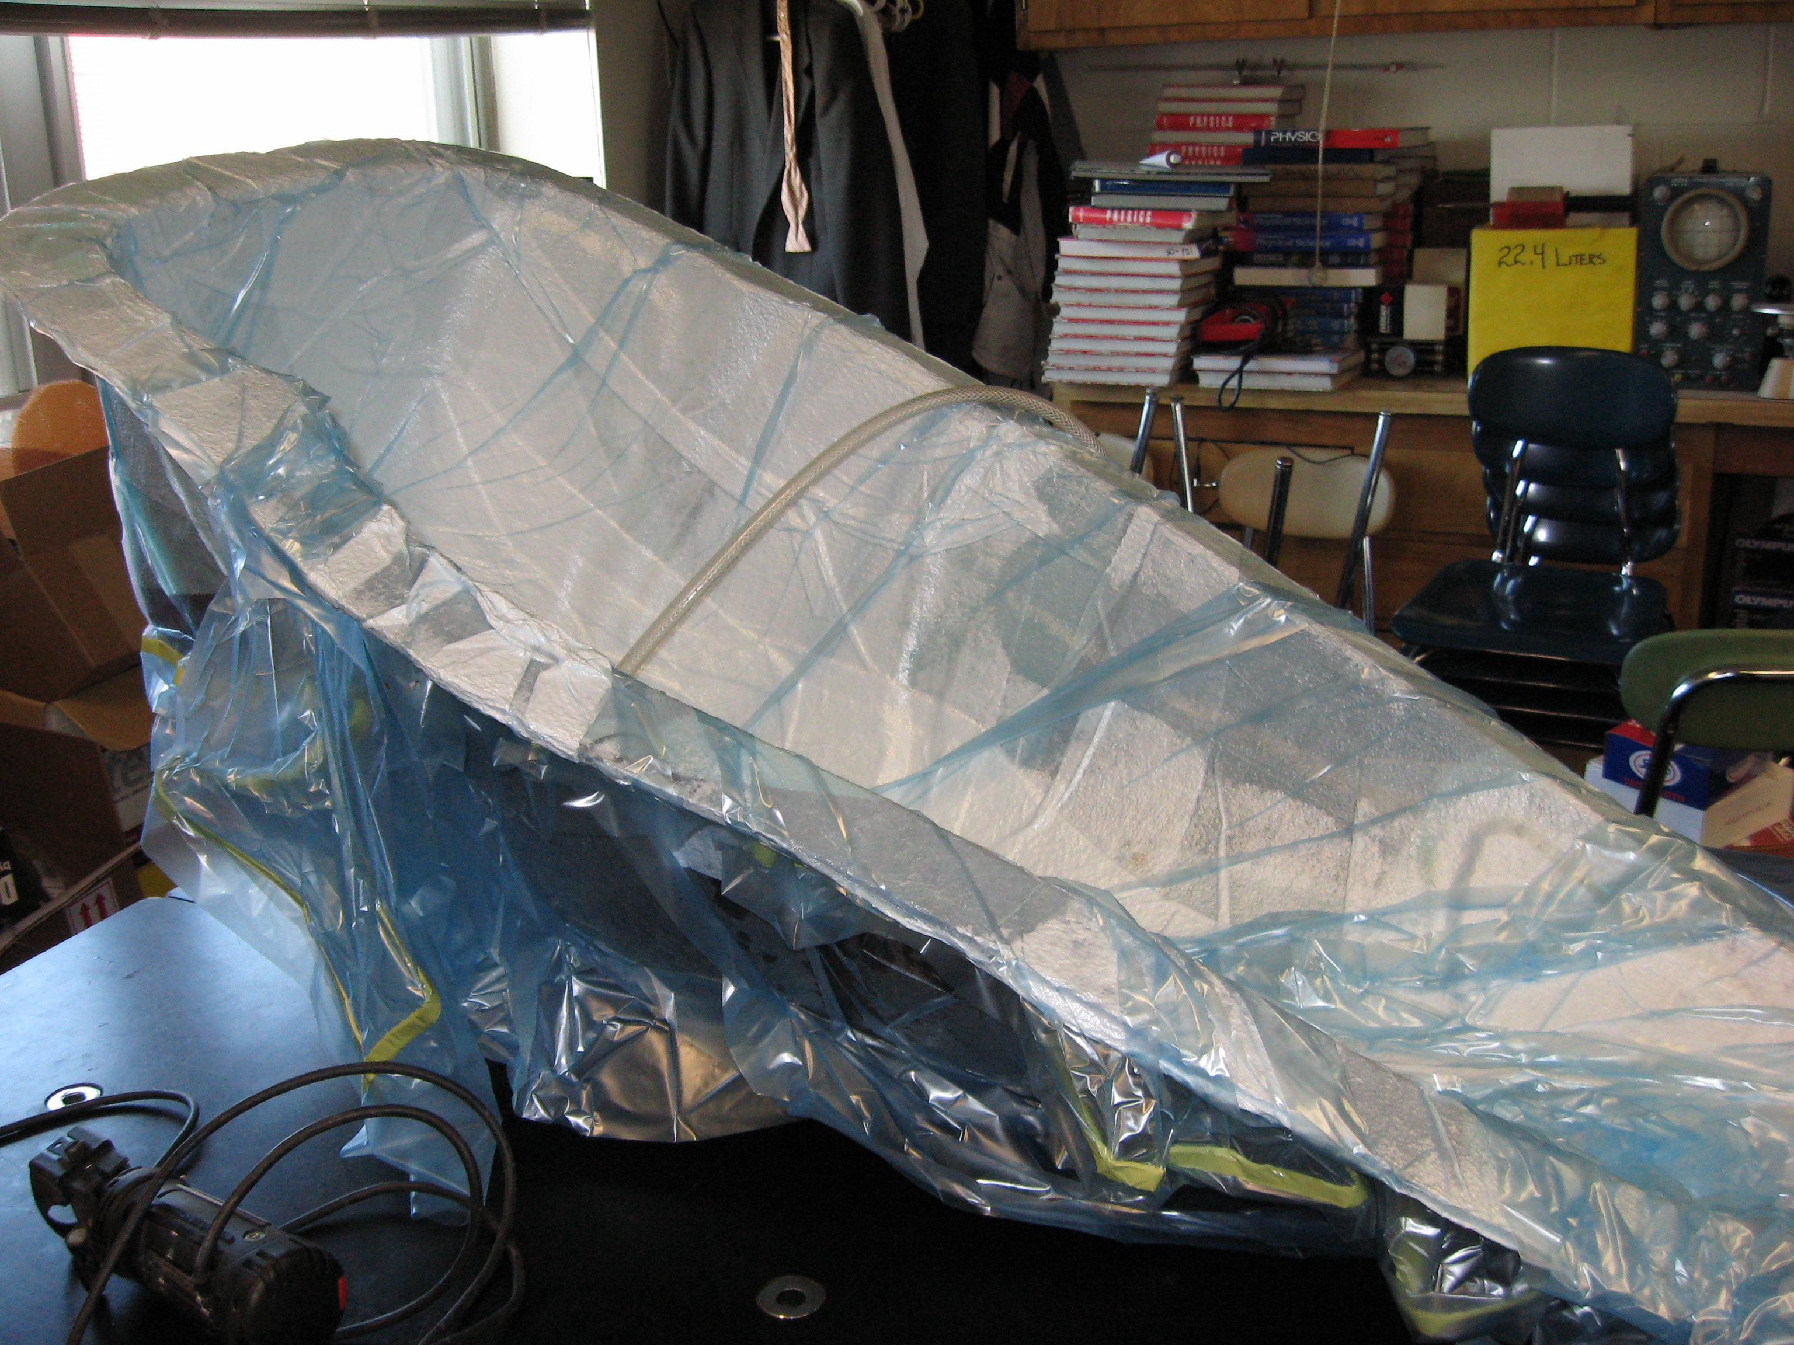
The Carbon Composite

Slide 21
Build it for less…..

Slide 22
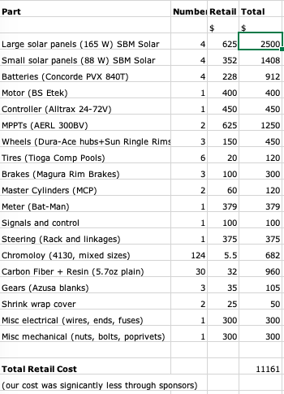

Slide 23
Shrink wrap and Foam-core

Slide 24
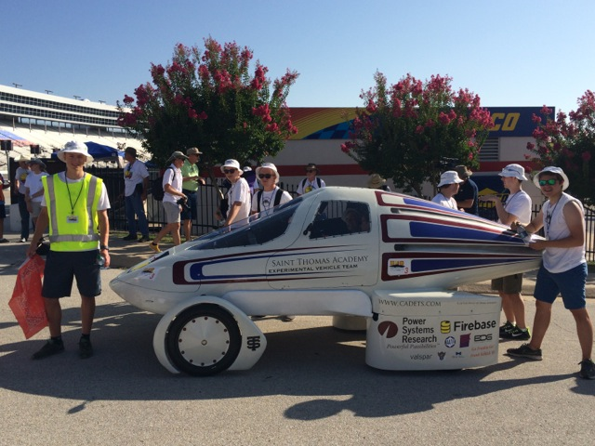
Solar Car Challenge Battery Electric Division

Slide 25
Carbon fiber body

Slide 26
Solar Charging Station

Slide 27
My friend Lehman Marks

Slide 28
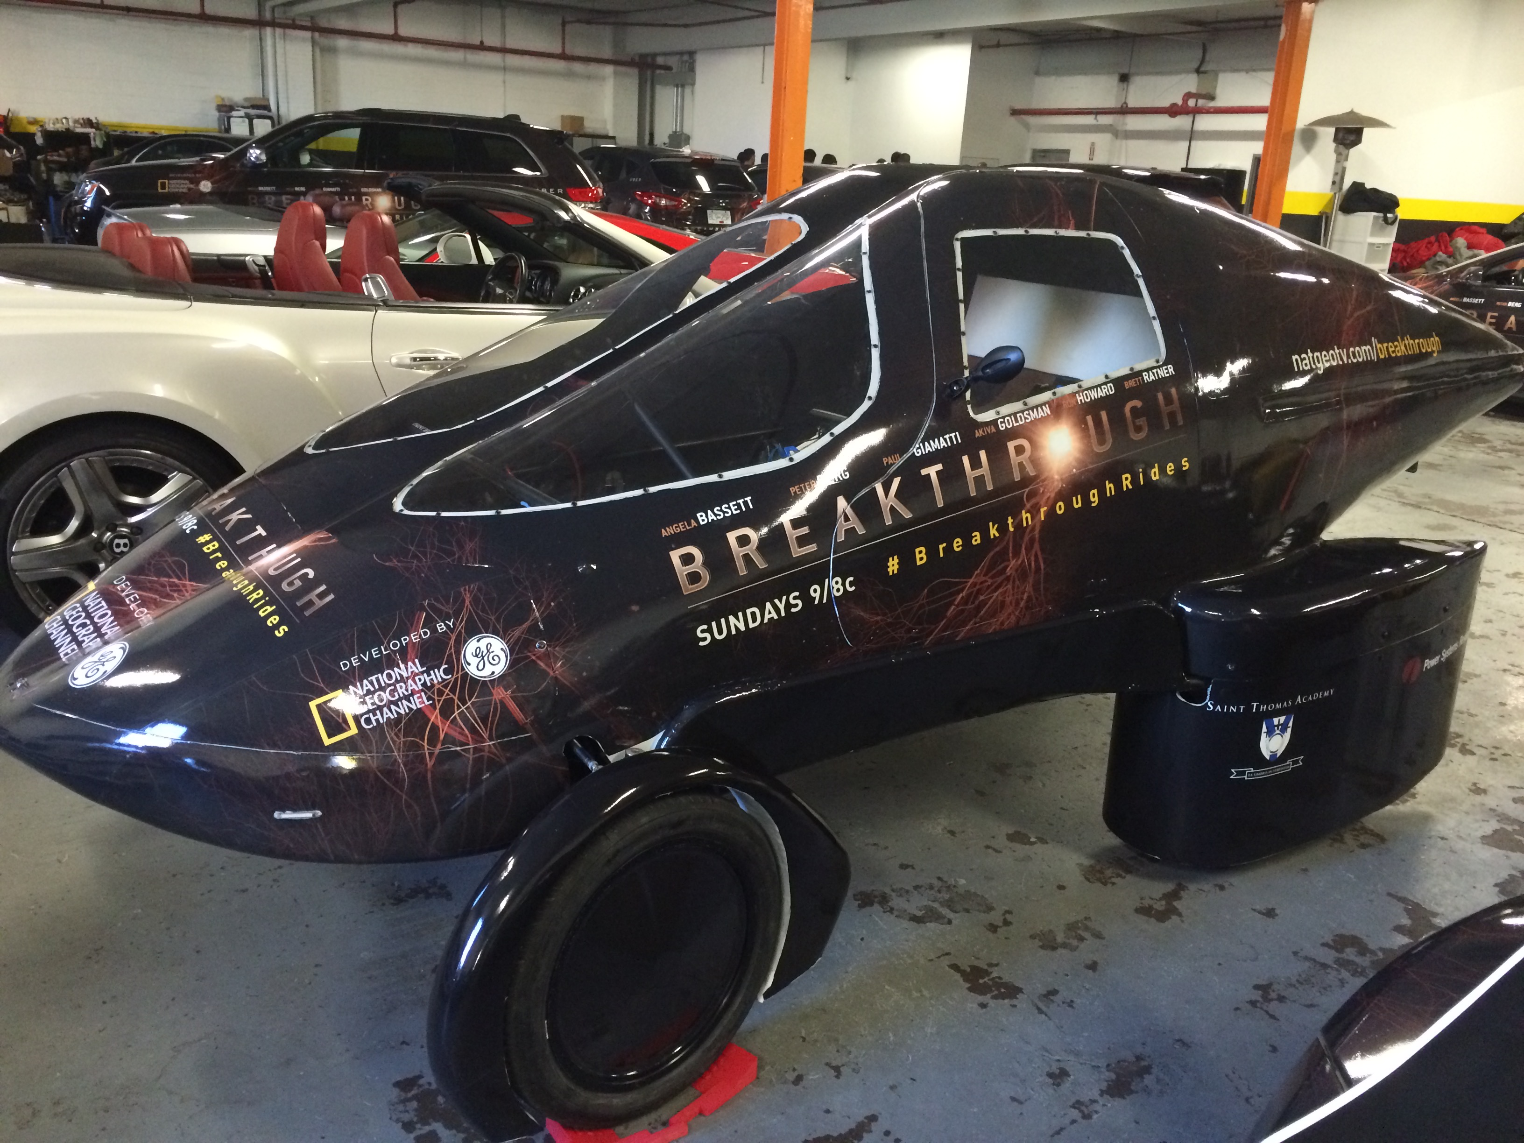
National Geographic New York City

Slide 29
No aerodynamics…..but possibly the most fun.

Slide 30
Drivers’ World Championship

Slide 31
Pista di Fiorano, Maranello Itay

Slide 32
Aerodynamics and Friction
Going farther on less: getting the most out of your car.
The four things that you can realistically control:
Electrical efficiency
Losses due to electrical resistance
Losses due to poor gearing
Weight
Rolling friction
Aerodynamic drag

Slide 33
Design Criteria
Design your car to be efficient from the beginning!
Solar Power: 10% more power will give you a 4% increase in performance.
Aerodynamics: 10% less drag will give you 3.1% increase in performance
Rolling resistance: 10% less resistance will give you 1.3% increase in performance.
Weight: 10% less weight will give you 0.9% increase in performance

Slide 34
Electrical Efficiency
Choose the correct gauge wire for the current you expect to draw.
Most cars use 4 gauge or lower for the drive system in the car.
Soldered connections are more efficient than crimped connections.
Connections can be checked with an infrared thermometer.
Heat = energy loss!

Slide 35
Bench testing electrical system

Slide 36
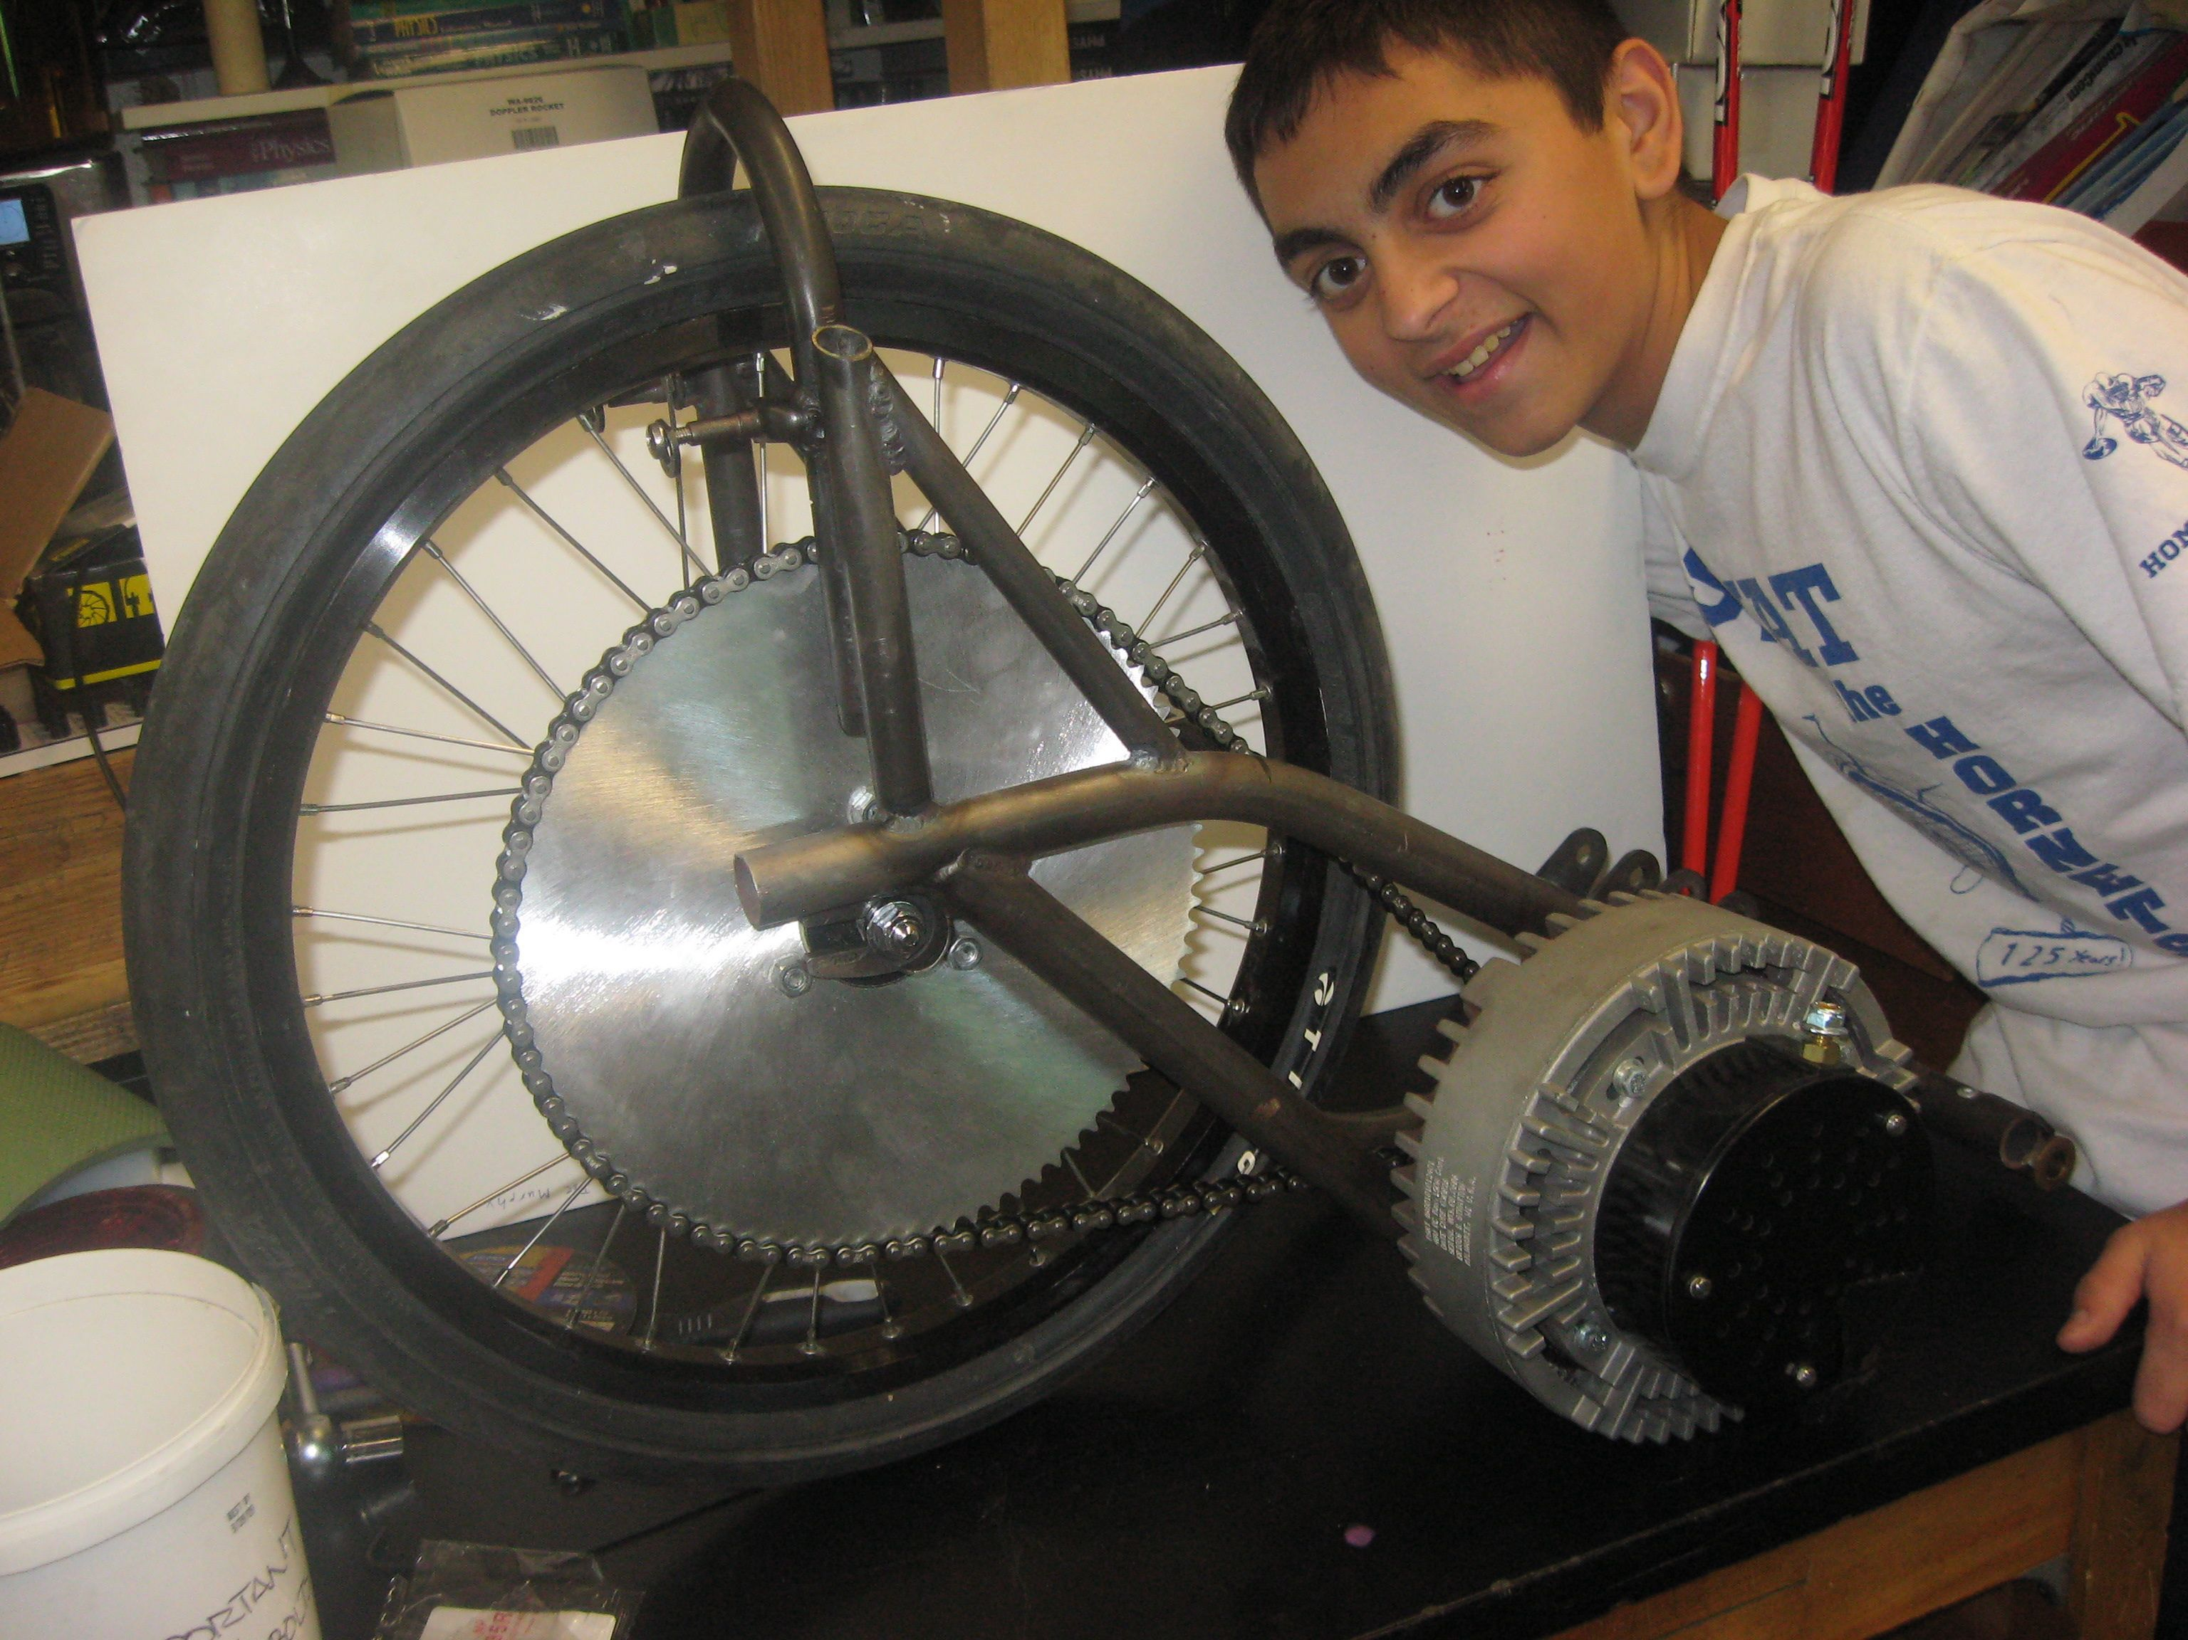
Choose the Correct Gears
Don’t gear a car for 50 mph if you are going to drive it at 25 mph. Be realistic about your cars speed!
Chain drive systems can be very efficient if gears are aligned and lubricated.
Pictured: 48V system, 15 tooth front, 70 tooth rear. Max speed = 36 mph

Slide 37
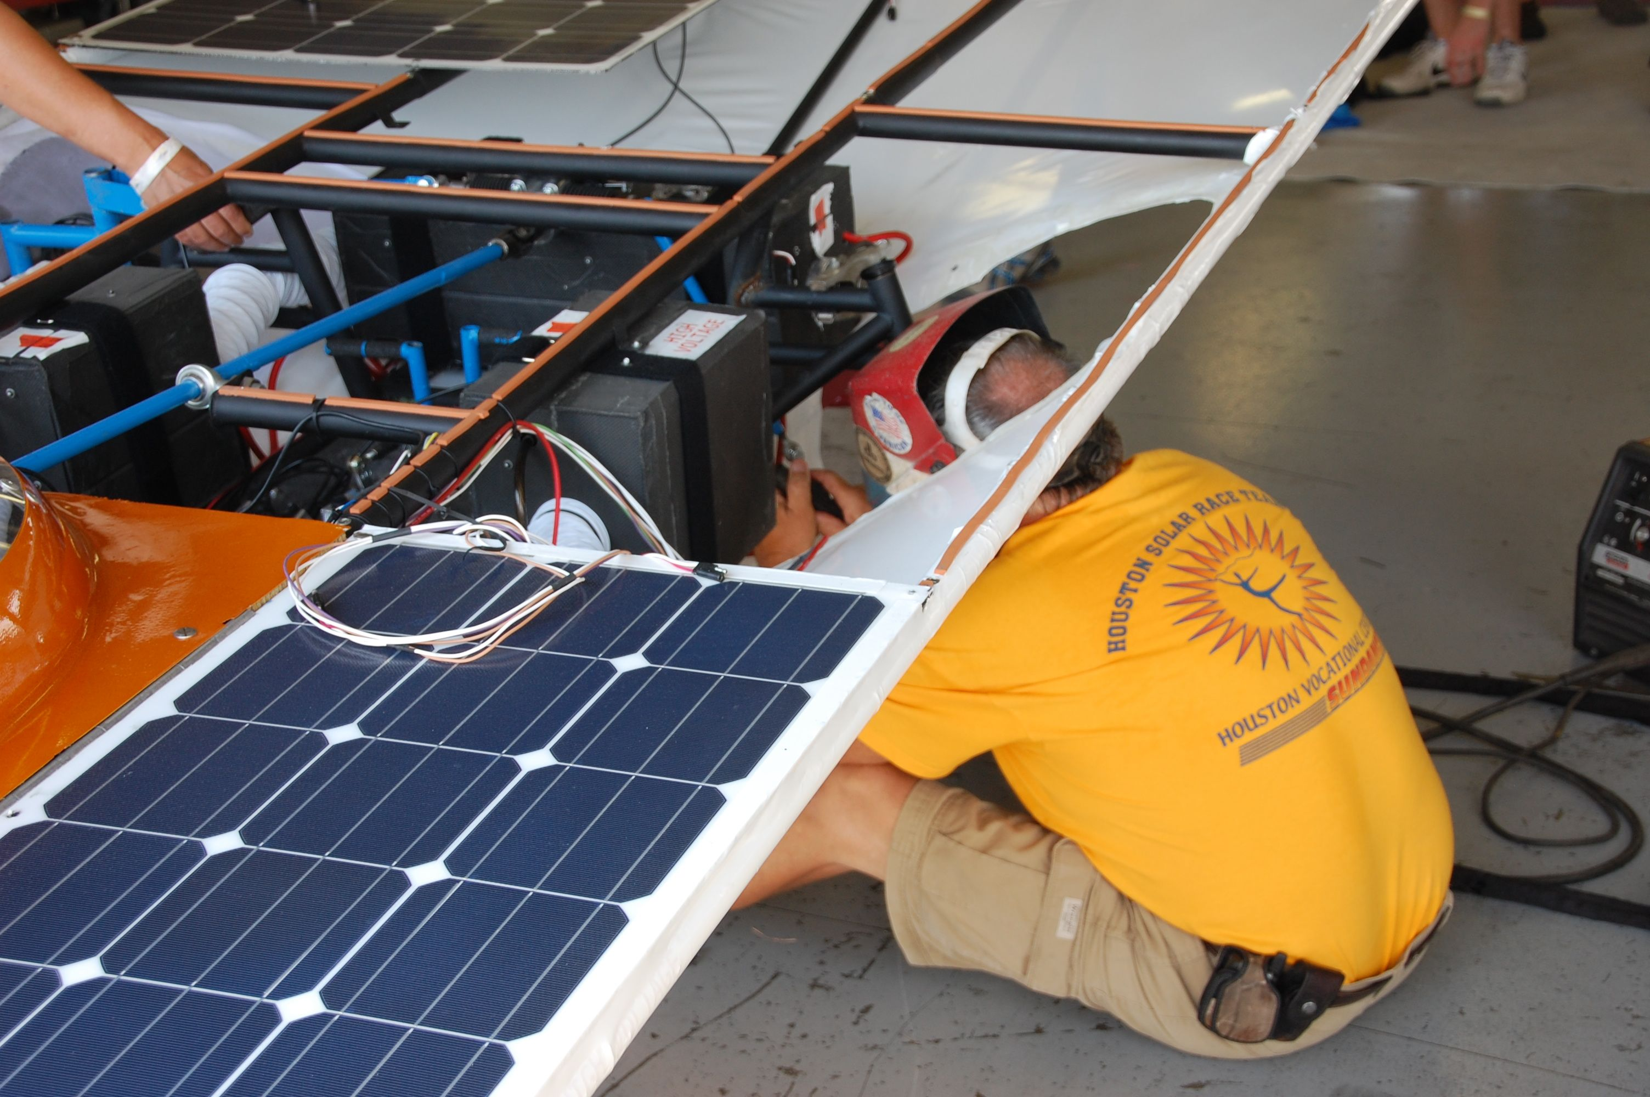
Weight
Heavier cars have more rolling resistance and take more energy to accelerate. (Much bigger problem in a road race.)
Do not reduce weight at the cost of safety.
Making things too light will cause things to break.

Slide 38
Rolling Resistance
Bearings can be opened, cleaned, and filled with a light oil.
Tires with thin “supple” casings roll better than thick casings. (Higher risk of flats)
Fat tires roll better than thin tires. (But weigh more.)
If it rotates: lubricate!
Wheel alignment is critical to reducing rolling resistance.

Slide 39
Aerodynamic Drag

Slide 40
Aerodynamic Drag

Slide 41
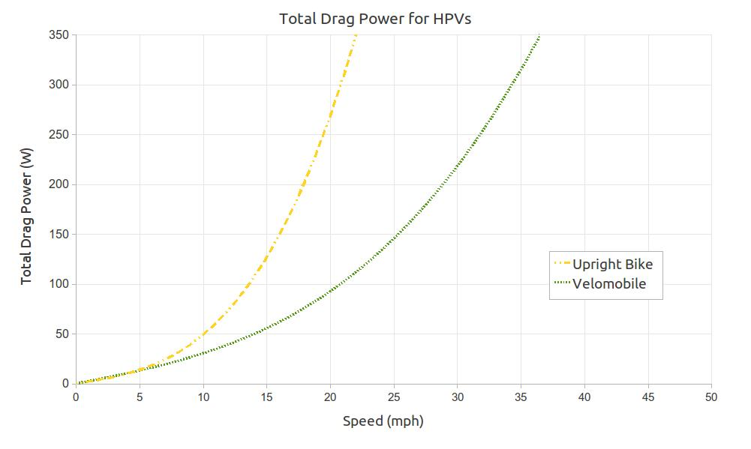
Aerodynamic Drag
This is the enemy number one to a solar car’s efficiency.

Slide 42
Aerodynamic Drag
Reducing drag is the least expensive way to improve your solar car.
The extra weight of drag reducing fairings is easily made up for in aerodynamic efficiency.

Slide 43
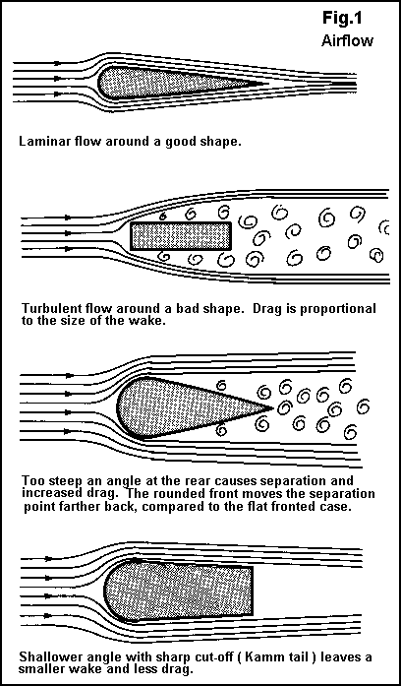
Aerodynamic Drag
Drag starts at the back of the vehicle, not the front. Hence the name “drag”.
Choose shapes that release airflow smoothly.
Fairings can be made from many common and light weight materials.

Slide 44
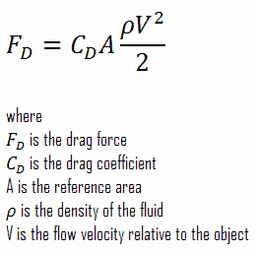
Aerodynamic Drag
When you double your speed, the force on your car is 4 times greater!

Slide 45
Relative Aerodynamic Drag

Slide 46
Barn Owl

Slide 47
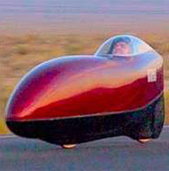
Ecomodders and HPVers
International Human Powered Vehicle Association https://www.ihpva.org/home/
Automotive Economy Modifications https://ecomodder.com/

Slide 48
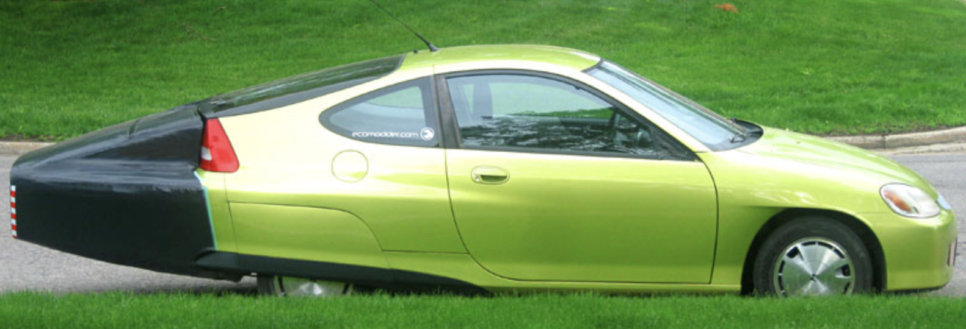
10-15% increase in efficiency.

Slide 49
Inexpensive Solutions

Slide 50
Inexpensive Solutions

Slide 51
Fairings for Tubes
3D Printed in segments

Slide 52
Energy Savings
For a 1 meter long, 1 inch diameter tube traveling 20 mph:
 | Round Tube | Aerodynamic Tube
Drag Force (Newtons) | 1.5 | 0.18
Energy per Lap (Joules) | 3621 | 434
Power Needed (Watts) | 13.5 | 1.7
Energy for 10 Laps (Joules) | 36,210 (36kJ) | 4340 (4.3kJ)
Energy for 300 Laps (kilojoules) | 1086.3 kJ | 130.2 kJ
Four Tubes | 4345.2 kJ | 520.8 kJ
You use about 1.5% of your solar array just to push tubes through the air! (Approximately 4 solar cells at 20mph, 6 solar cells at 30mph)
It takes more than 8 times the energy to push a round tube through the air than an aerodynamic tube!

Slide 53
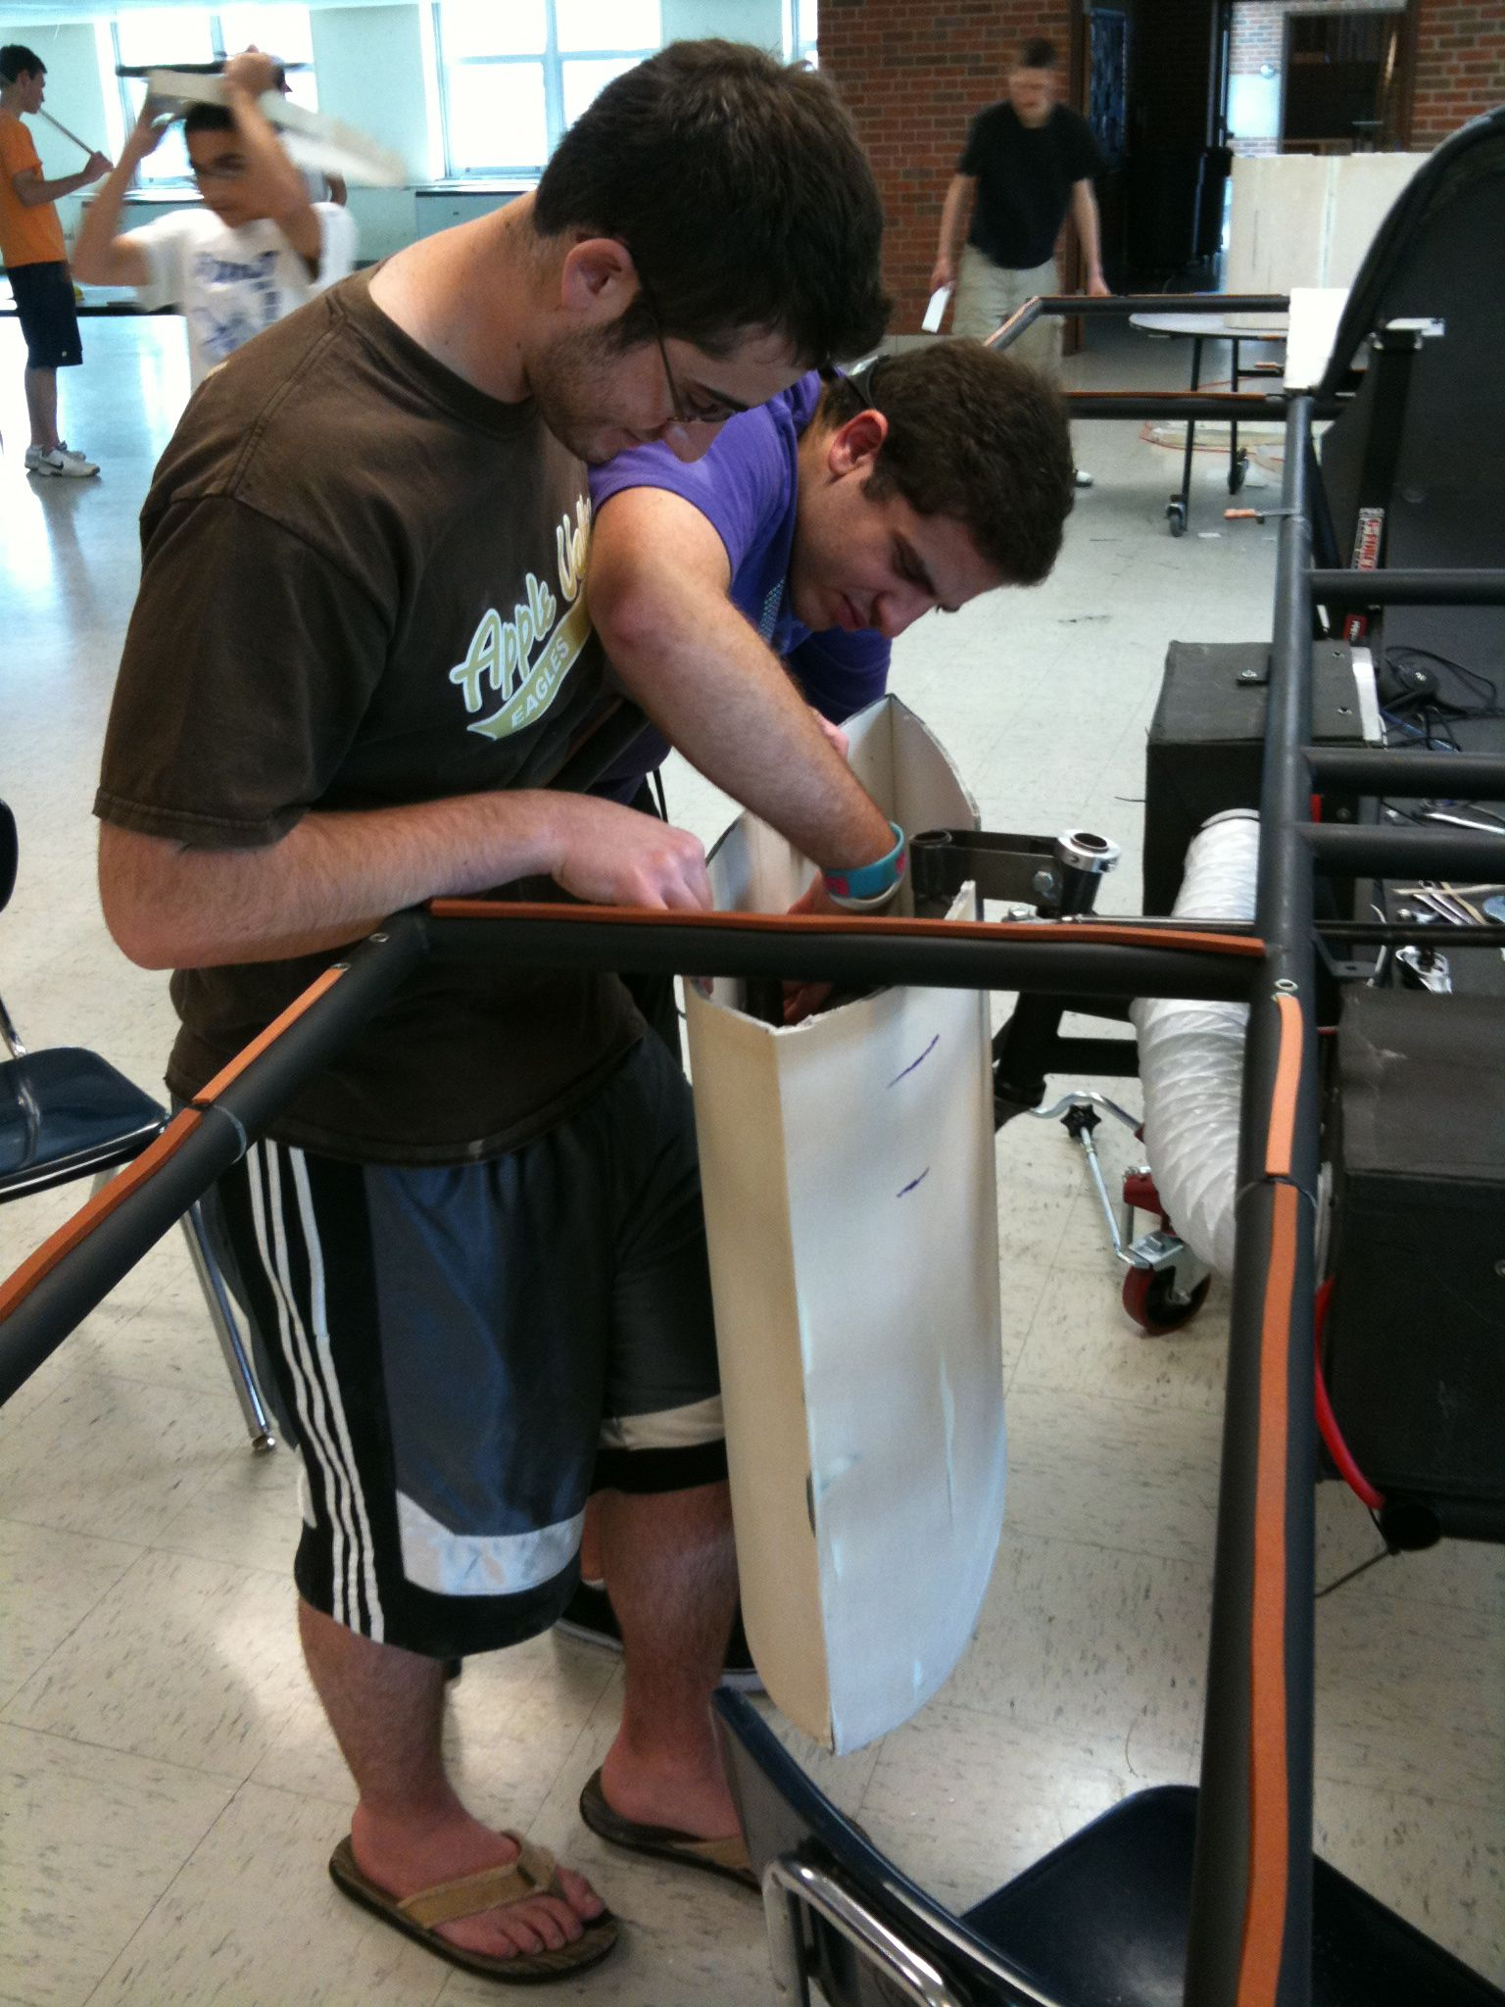
Inexpensive Wheel Fairing
Things you need:
Foam core board
Razor Blade
Hot glue
Carbon fiber or Fiberglass reinforcement
Epoxy resin
Creativity
Body filler

Slide 54
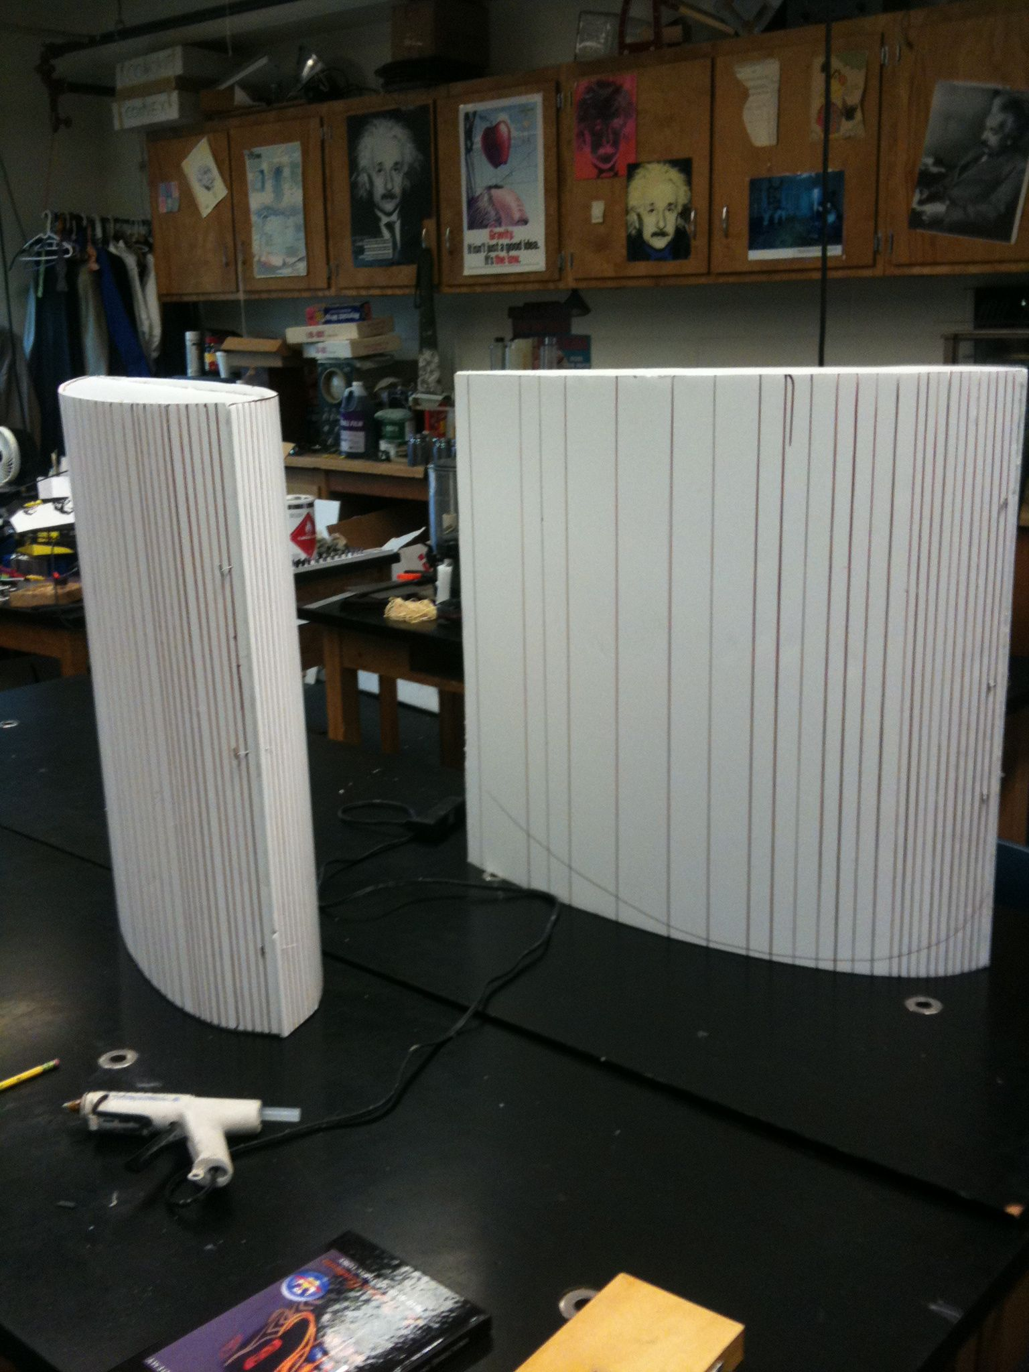
Wheel Fairings
Cut foam core board to shape
Score with a razor blade
Bend to shape
Glue

Slide 55
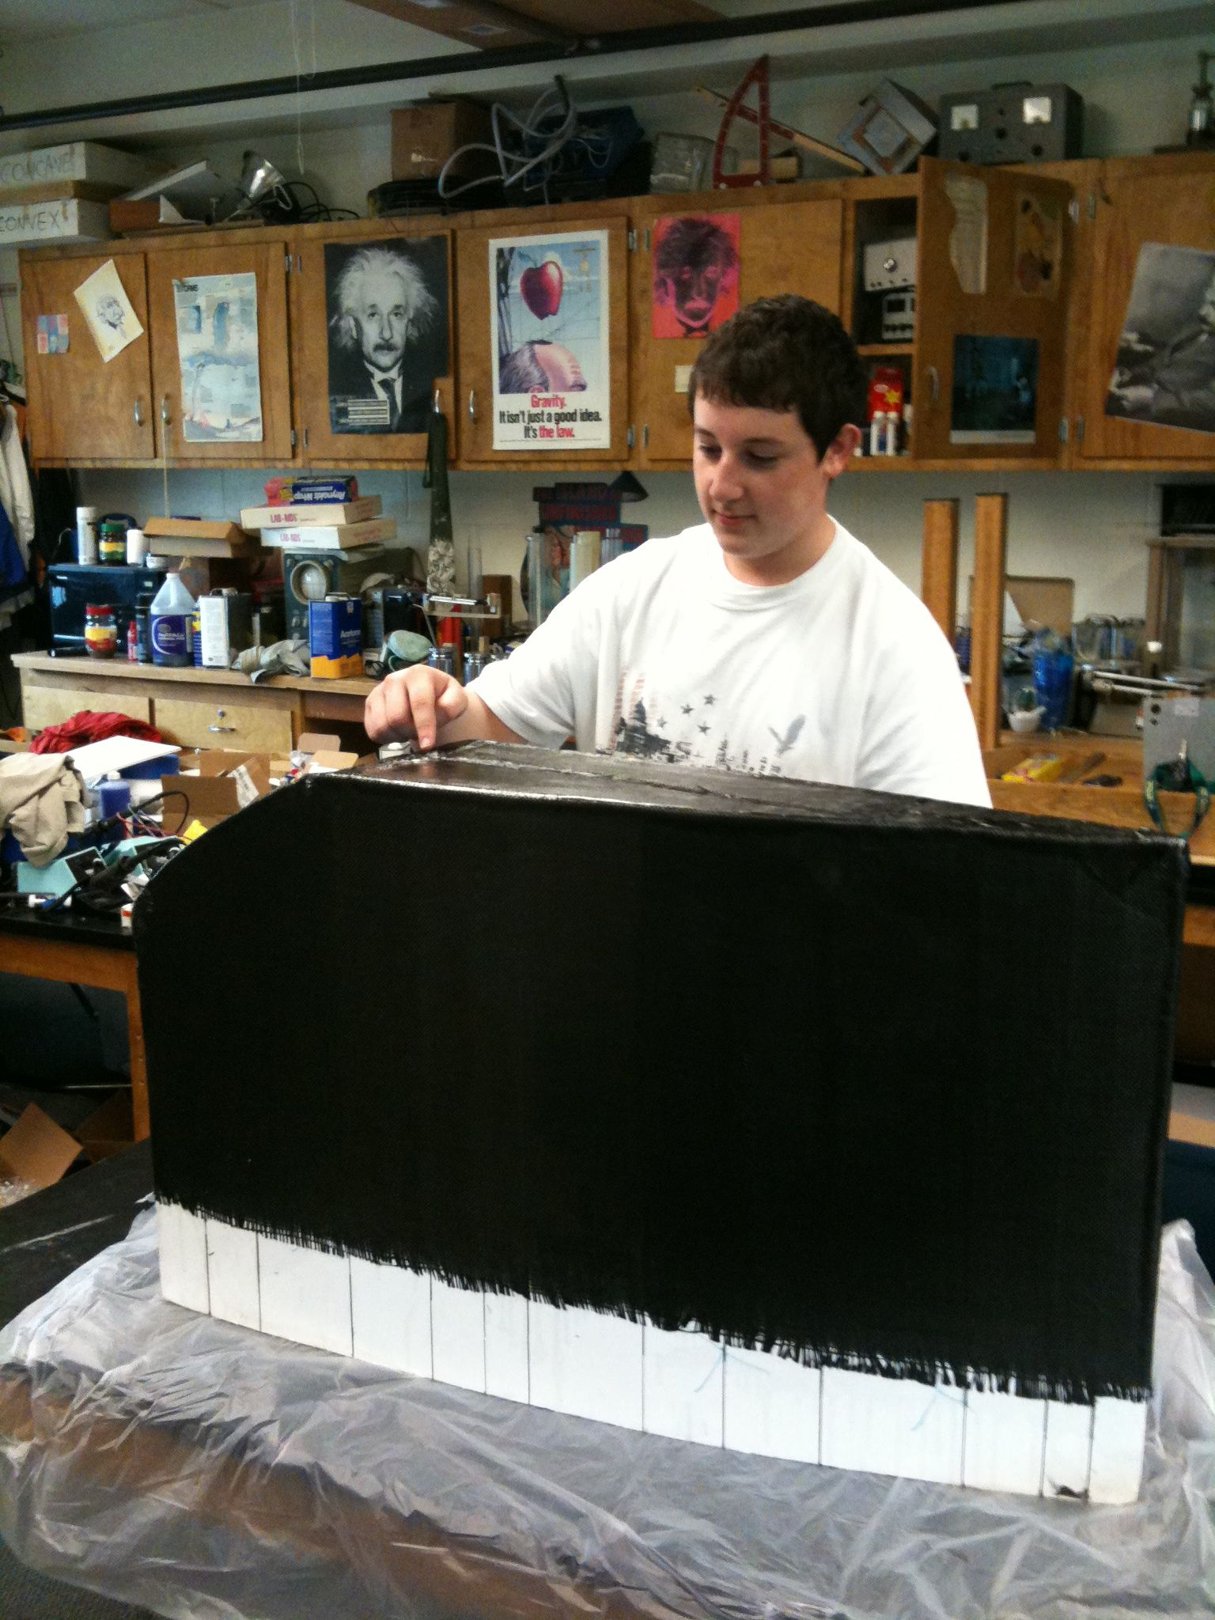
Adding Reinforcement
One or two layers of Carbon or Fiberglass cloth is enough.
Epoxy resin won’t eat through the foam core.
Squeege excess resin from fabric.

Slide 56
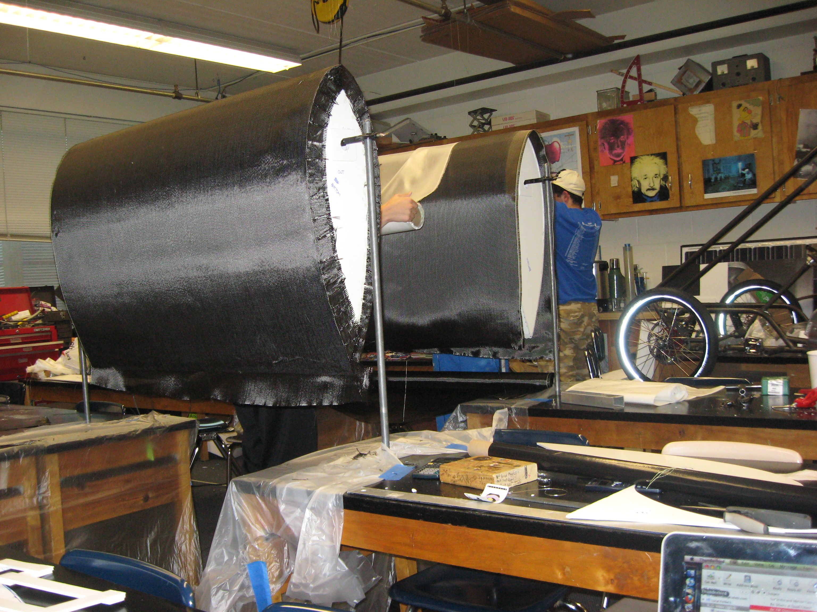
Adding Reinforcement
Add some carbon fiber squares on the inside at attachment points to strengthen foam core board.
Trim with a common jigsaw to fit.

Slide 57
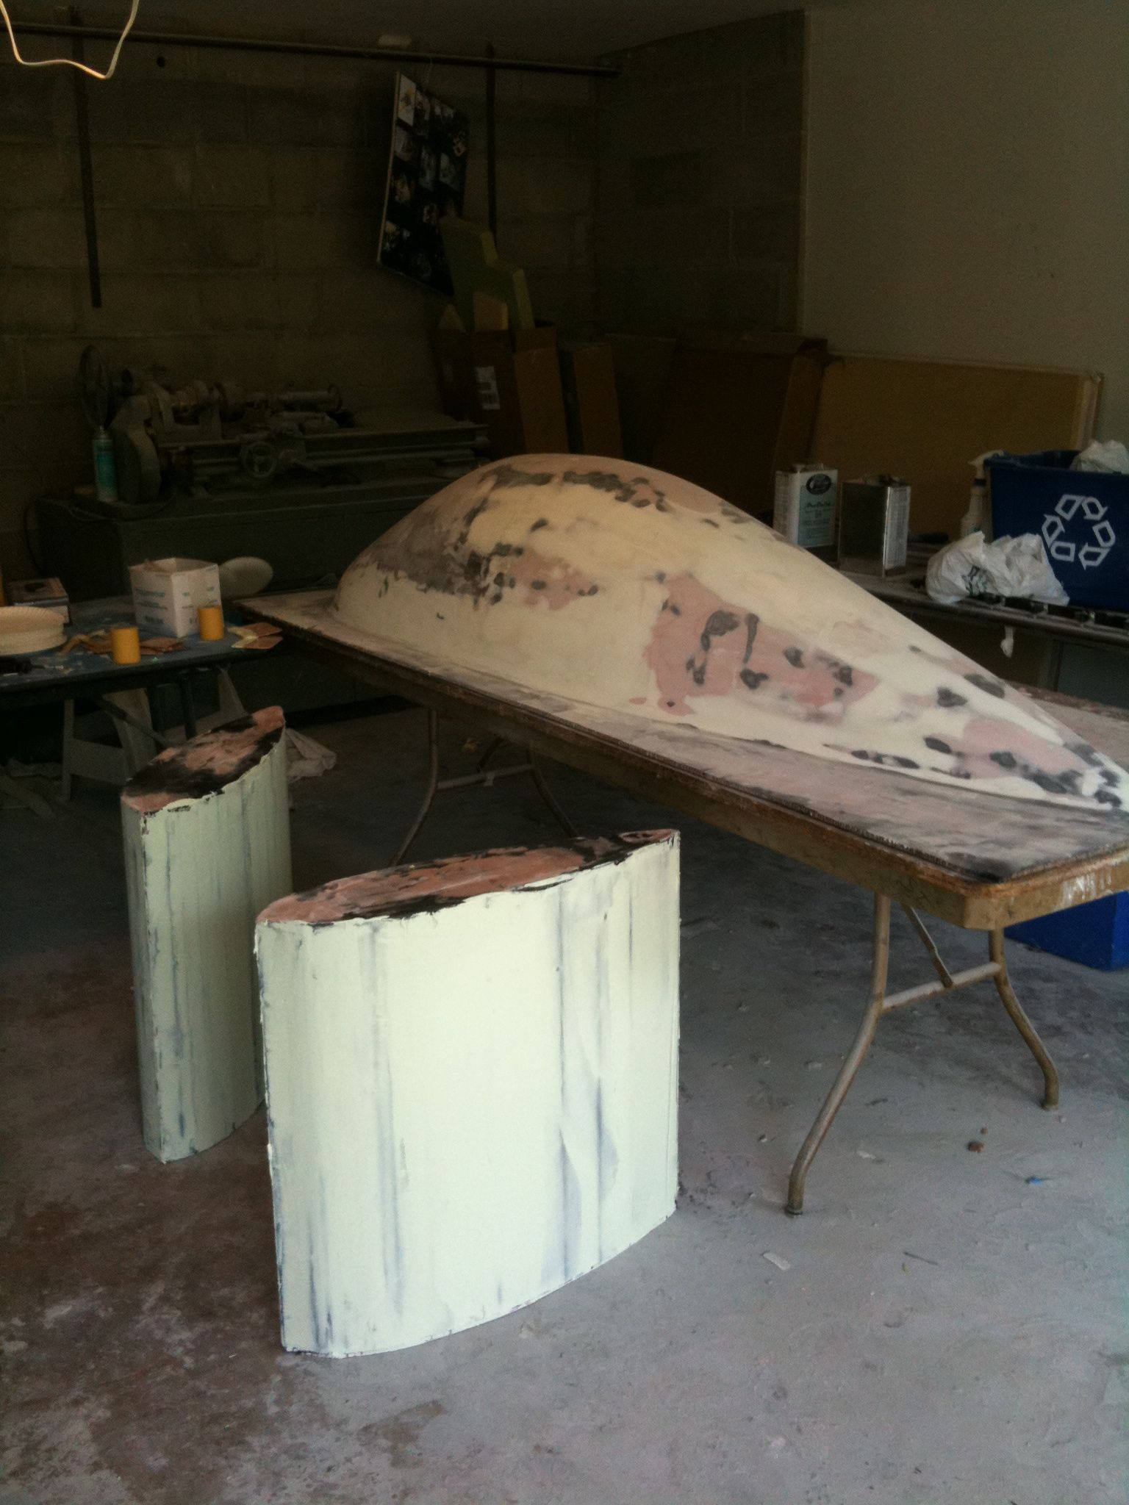
Finishing
Reinforcement is covered with a light-weight body filler and sanded smooth.
Prime and paint
(A good painter can cover a lot of flaws!)

Slide 58
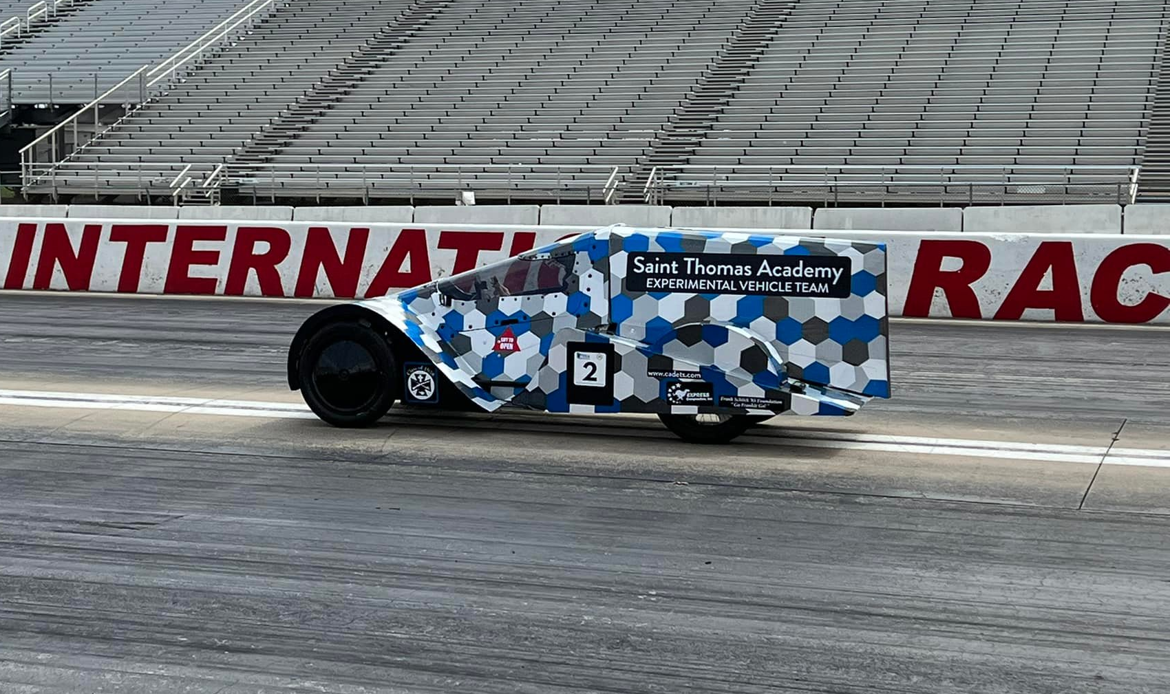
A complete car from foamcore

Slide 59
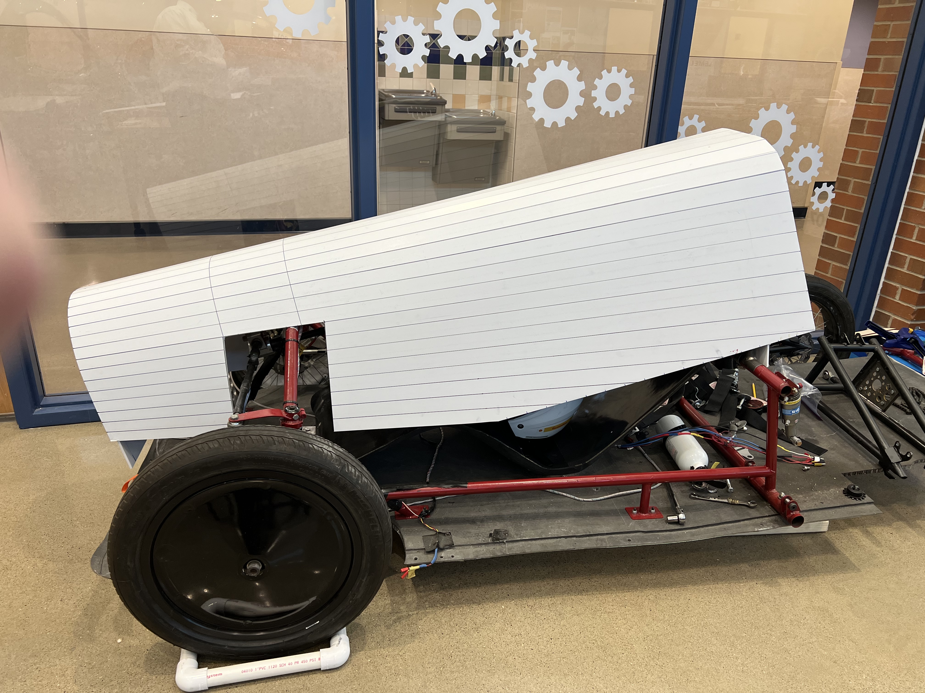
A complete car from foamcore

Slide 60
A complete car from foamcore

Slide 61
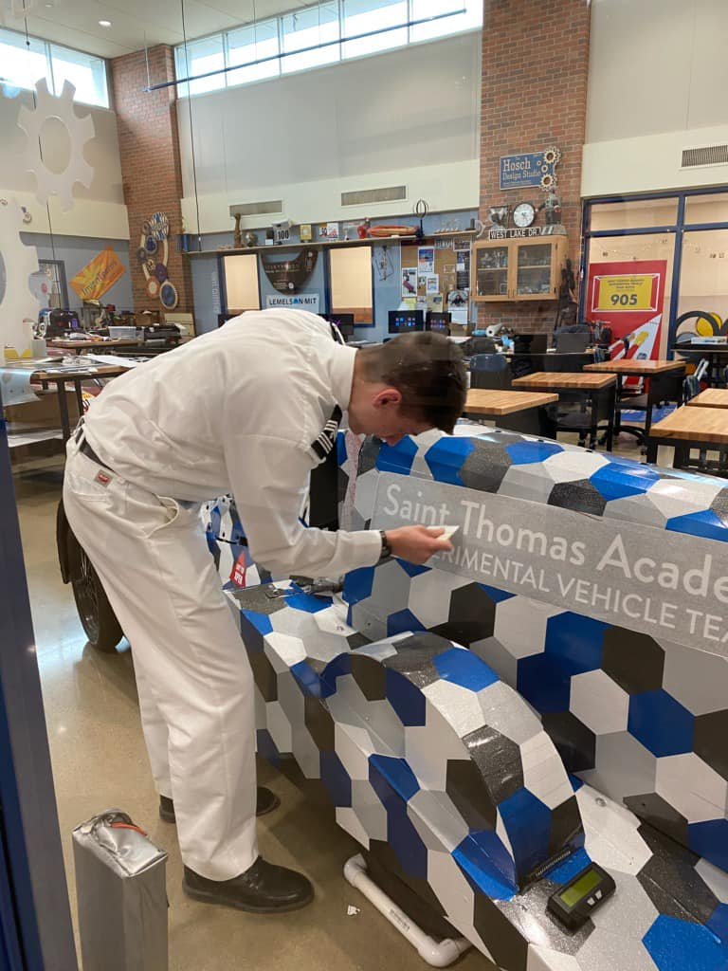
A complete car from foamcore

Slide 62
Shrink Wrap Body Cover
Made from 7-mil shrink-wrap that is used to protect boats in the winter.
Shrink-wrap is cut to shape and taped to the car with inexpensive tape that is made for the material.
A common heat gun can be used to shrink the material.
The material cools and maintains a semi-rigid surface.
Easily repaired with tape.

Slide 63
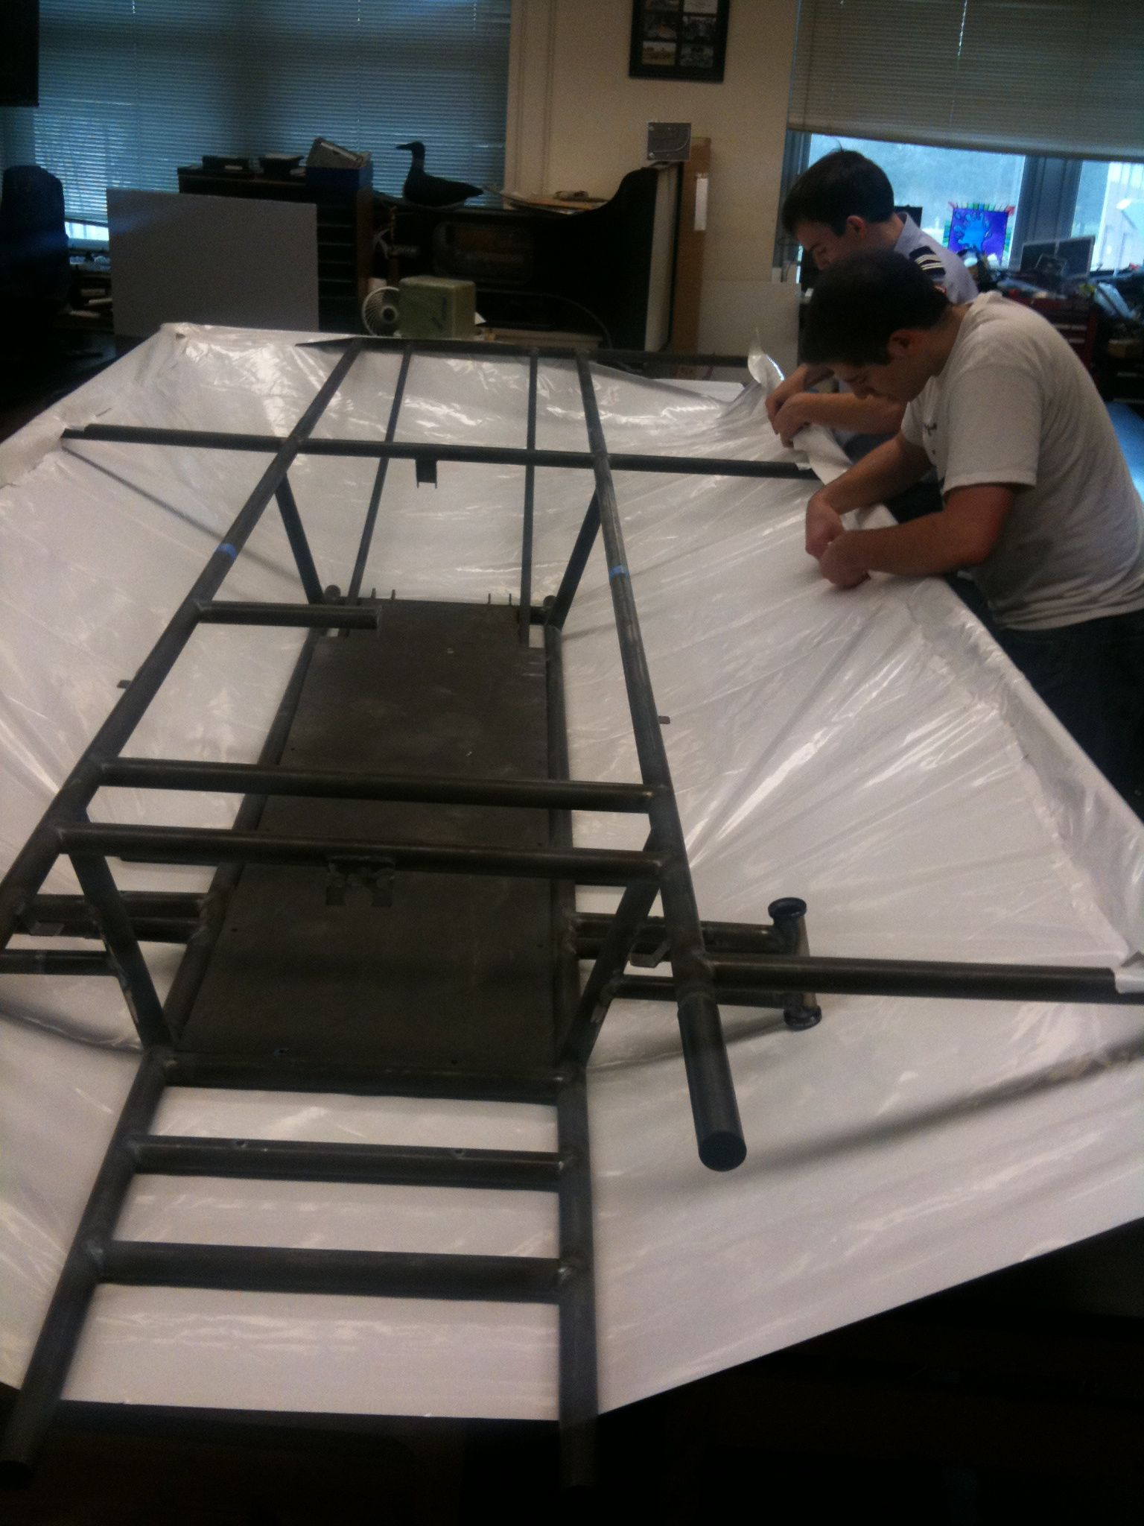
Cut and Tape the Material

Slide 64
Reinforce and Heat

Slide 65
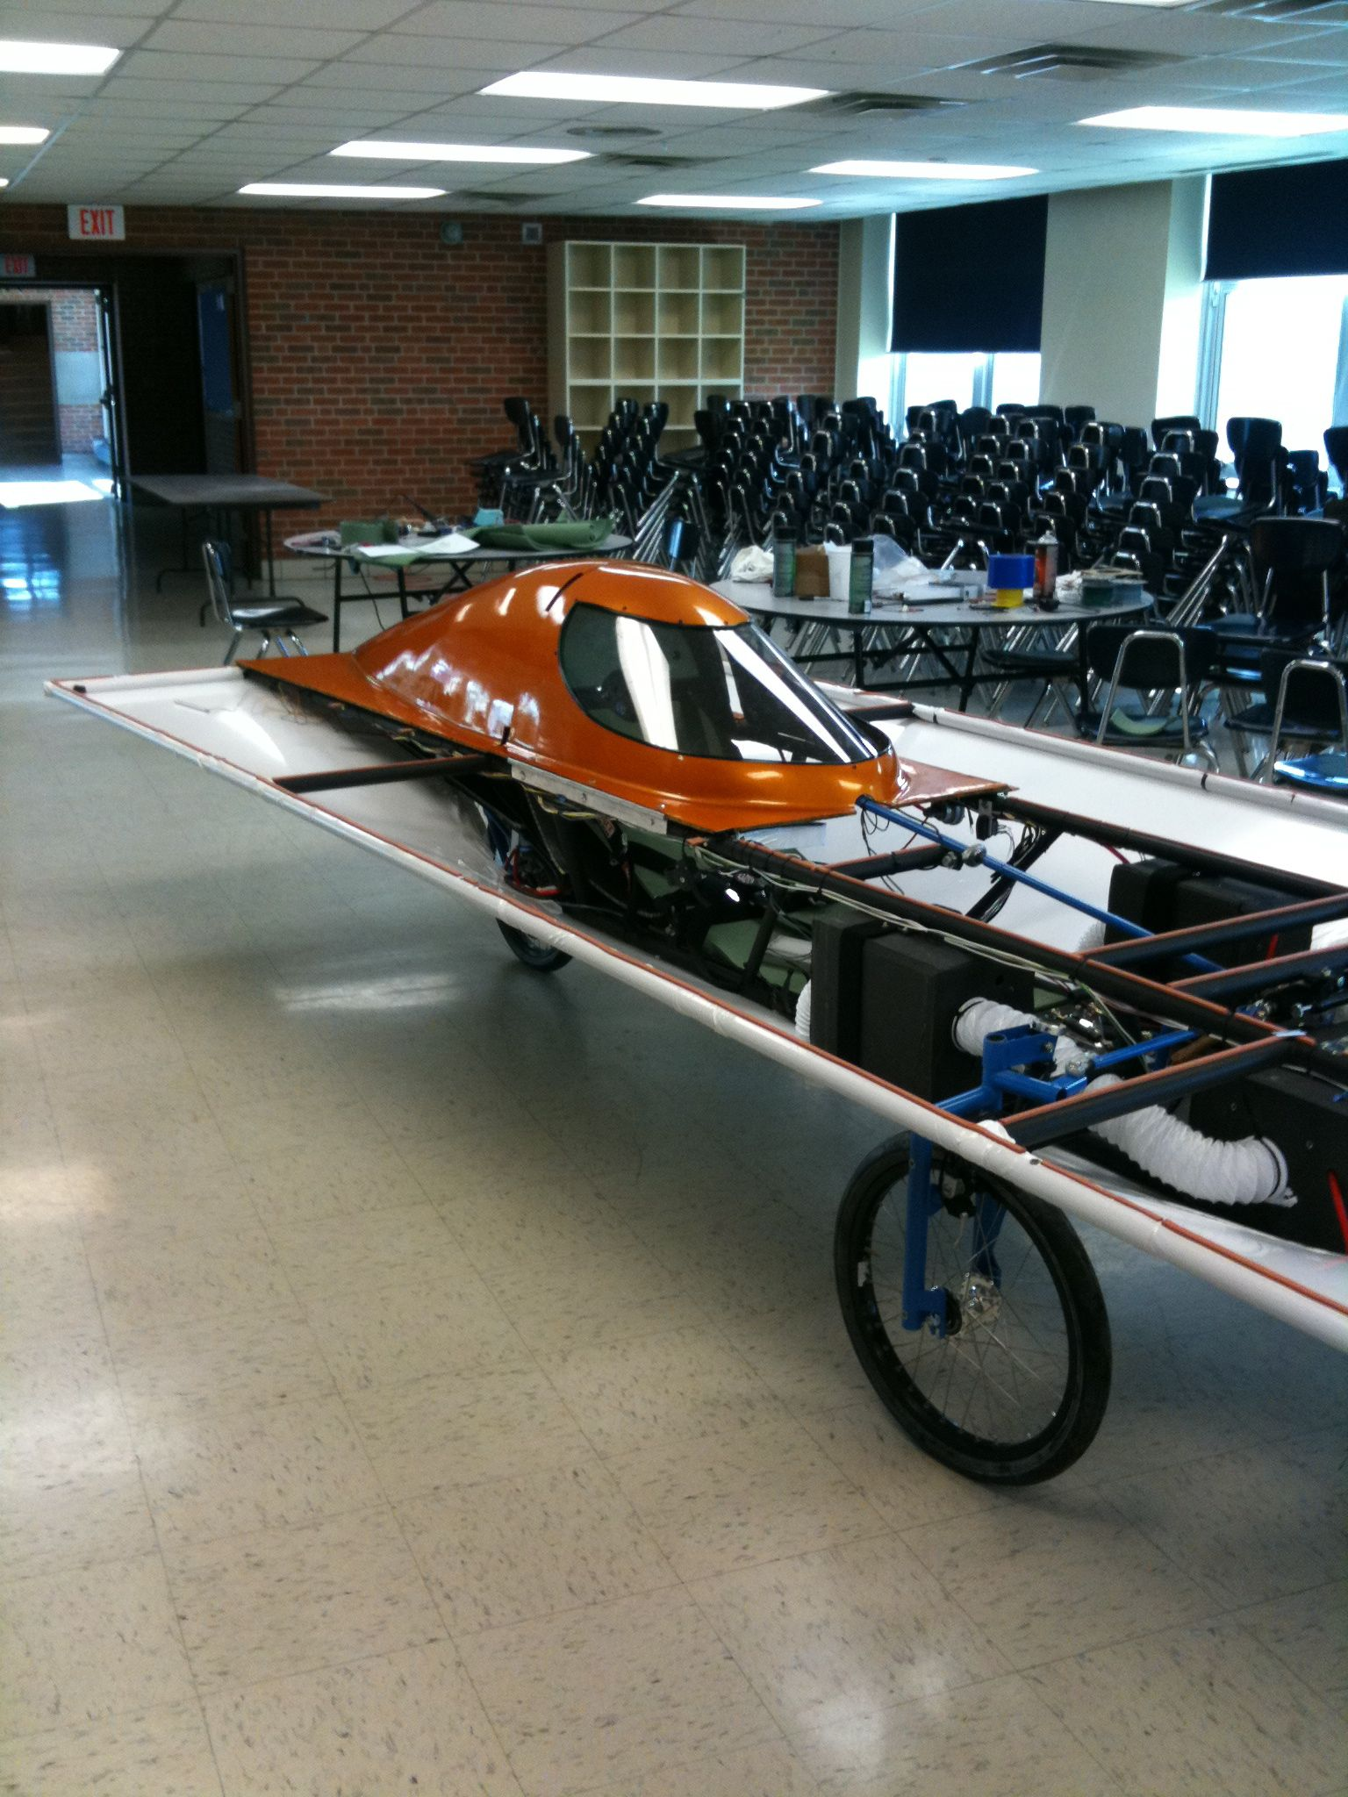
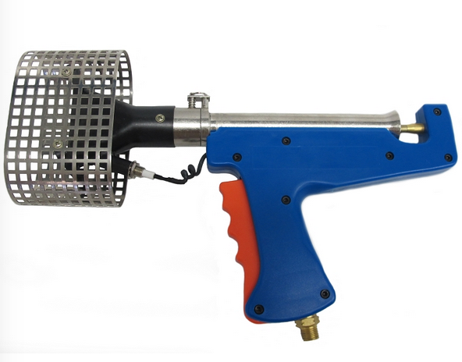
Trim to fit around fairings
Shrink Wrap
Big Shrink www.bigshrink.com
Comes in a variety of colors and thicknesses

Slide 66
Final product

Slide 67
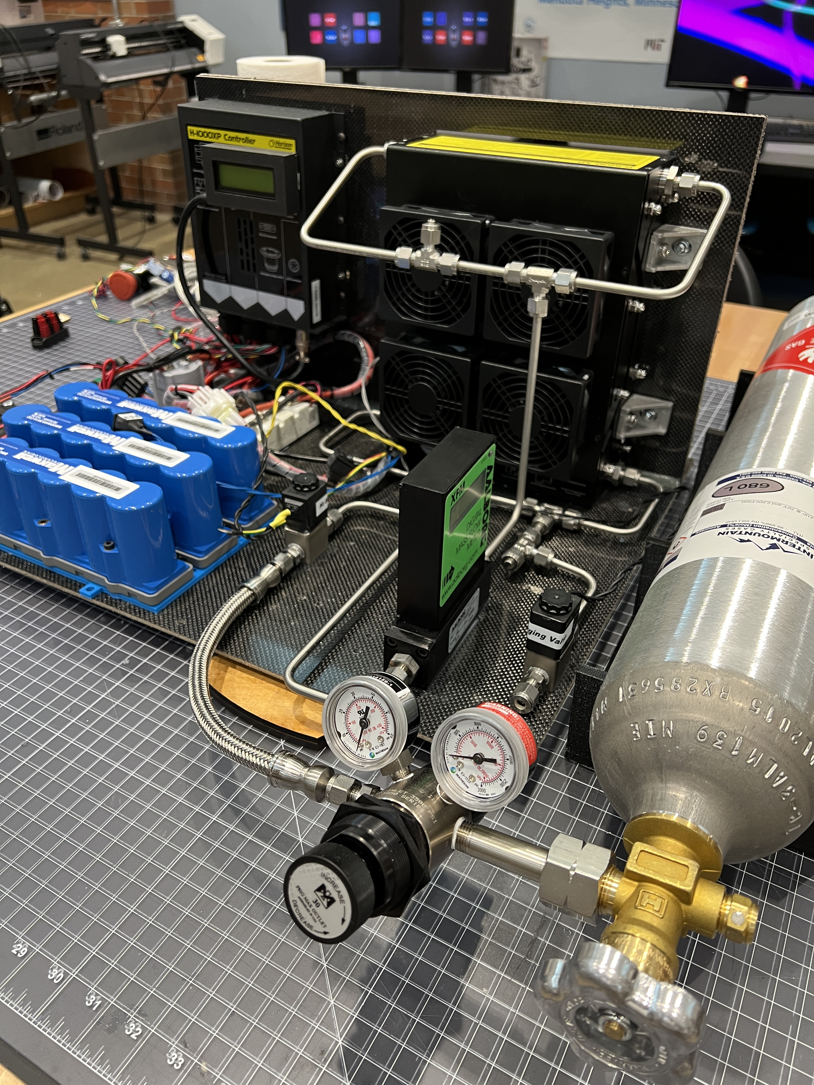
What is the Saint Thomas Academy Experimental Vehicle Team up to now?

Slide 68
3D Printed Mold

Slide 69
CAD Drawing of Mold Parts

Slide 70
Mold complete

Slide 71
Carbon Fiber Composite Parts

Slide 72
Finished Hydrogen Fuel-cell Vehicle

Slide 73
Contact information
Mark Westlake
mwestlake@cadets.com
Saint Thomas Academy Experimental Vehicle Team (St. Paul Minnesota)
Facebook: https://www.facebook.com/staEVT
Instagram: https://www.instagram.com/sta_evt/

Slide 74
Specialty Workshop
Solar Car Challenge

